Slide 1







DISCOVERIES & INSIGHTS FROM 2019 DEVELOPER SURVEY
Adedayo Abiodun Adeboye
10 October, 2023

Slide 2



OUTLINE
Executive Summary
Introduction
Methodology
Results
Visualization (Charts)
Dashboard
Discussion (discoveries & insights)
Conclusion

Slide 3

EXECUTIVE SUMMARY
Current Technology Usage
Top 10 Languages
Top 10 Databases
Platforms
Top 10 Web Frames
Future Technology Trend
Top 10 Languages desired next year
Top 10 Databases desired next year
Desired Platforms next year
Top 10 Web Frames desired next year
Demographics
Respondent classification by gender
Respondent count for countries
Respondent count by age
Respondent count by gender & classification
by education level

Slide 4

INTRODUCTION
In this project, we'll begin by extracting data from a website using its API, which contains the datasets we'll use. Afterward, we'll clean and prepare the data for thorough analysis. Our objective is to determine the most sought-after programming languages and databases, both currently and in the future. Additionally, we will assess the correlations among numeric data.

Slide 5

METHODOLOGY
Collection of data Using APIs
Data Wangling
Data Cleaning and preparation
Visualization Using IBM Cognos Analytics Dashboard Embedded

Slide 6
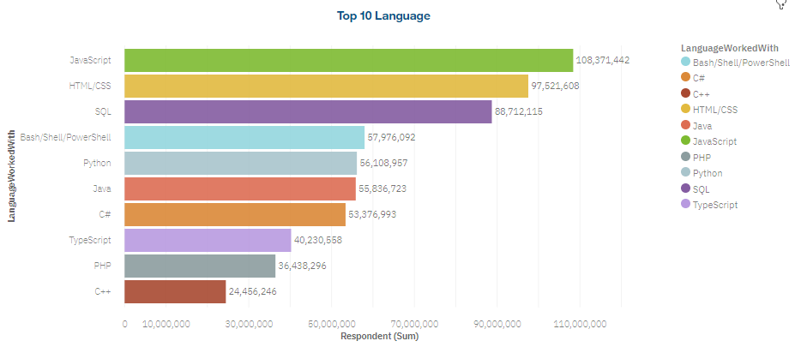
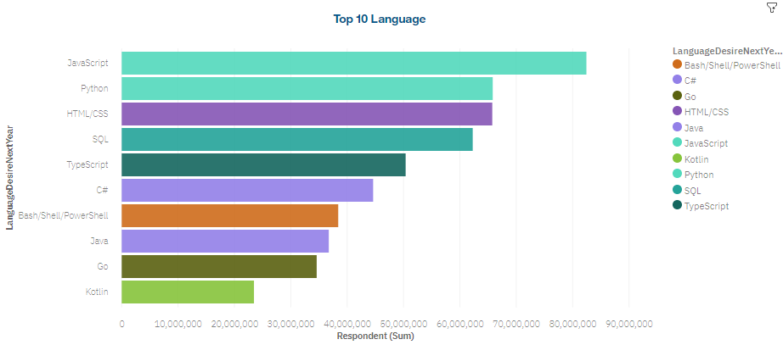
PROGRAMMING LANGUAGE TRENDS
Current Year
Next Year

Slide 7
PROGRAMMING LANGUAGE TRENDS - DISCOVERIES & INSIHGTS
Discoveries
JavaScript is currently the most widely utilized programming language, and it is expected to maintain its prominence in the future as well
HTML/CSS remains one of the most widely used language today and is expected to maintain its popularity in the future
Python is experiencing a growing trend in popularity
Insights
Both JavaScript and HTML/CSS are in demand now and are expected to remain relevant in future trends.
Python is currently a leading programming language in the latest generation
Java, C# C++ have seen a decline in their popularity and influence

Slide 8
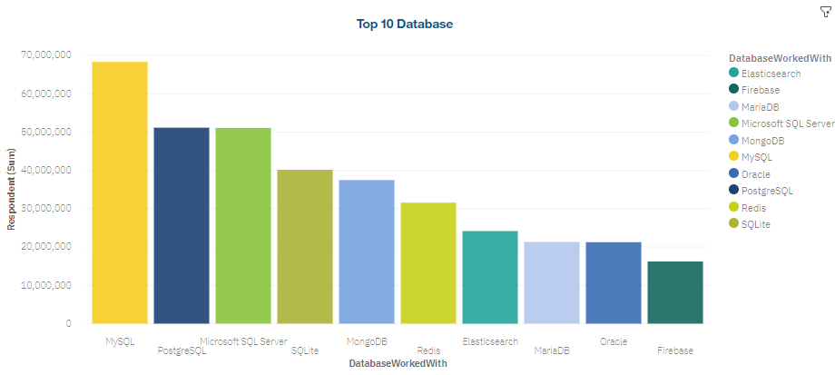
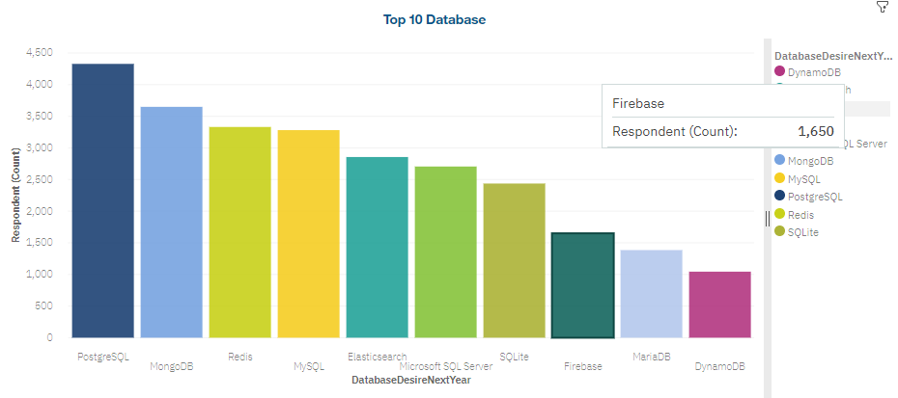
DATABASE TRENDS
Current Year
Next Year

Slide 9
DATABASE TRENDS – Discoveries & Insights
Discoveries
RDBMS are currently the prevailing trend in usage
NON RDBMS are poised to dominate future trends
Insights
Many individuals have a strong desire to acquire knowledge about non relational database
It’s evident that Big Data will gain significant popularity in the years ahead

Slide 10

DASHBOARD
https://eu-de.dataplatform.cloud.ibm.com/dashboards/beade045-bd51-419b-83ad-25cc78eedcf1/view/4714d87c38e26cdf42d4cce407cd2e0e293f2308e3bb850787827b4959637497f36b1692c87d1a5cdc125035a2b9135eca

Slide 11
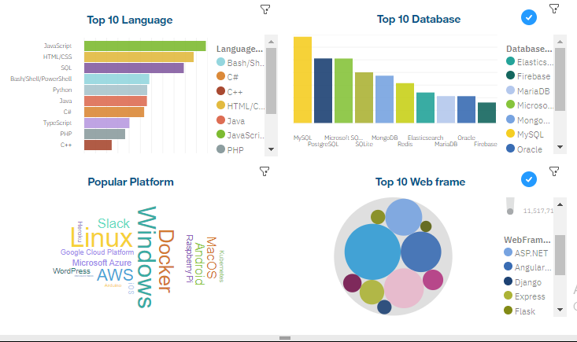
DASHBOARD TAB 1 (Current Technology Usage)
.

Slide 12
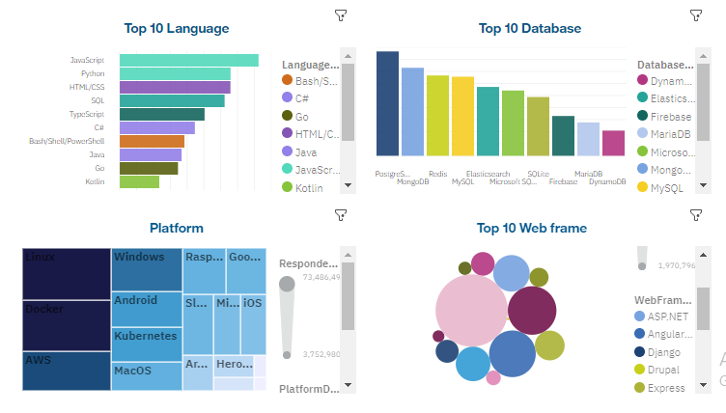
DASHBOARD TAB 2 (Future Technology Trend)
.

Slide 13
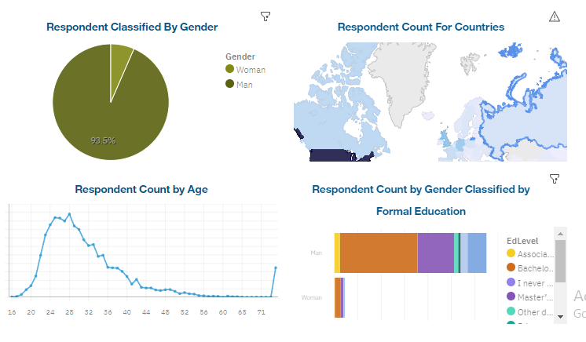
DASHBOARD TAB 3 (Demographics)
.

Slide 14
DISCUSSION
Based on the visualization, it’s evident that the future is heading toward a prominent role for big data. Consequently, possessing expertise in big data manipulation couple with proficient in advance programming language will be a crucial differentiator in the time ahead

Slide 15

CONCLUSION
Observing our visualization dashboard, it's evident that the future demands proficiency in advanced programming languages such as JavaScript and Python. Additionally, don't underestimate the significance of understanding HTML and CSS. These skills will empower future developers to effectively manage and manipulate large datasets. Furthermore, we strongly advocate for greater female involvement in programming, as our visualization highlights a limited representation of women in the programming community. Thank you for your attention to these important insights.

Slide 16
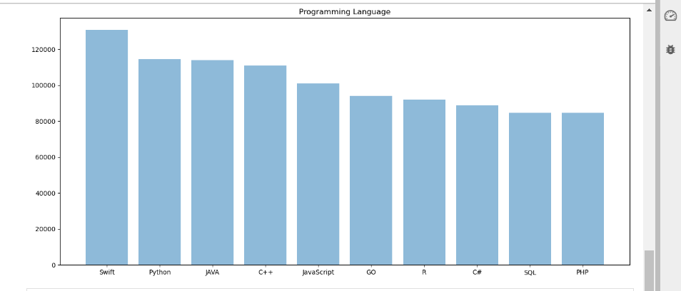

Slide 17
